Slide 1
Artificial Intelligence Assignment #1
Download at: http://pcred.yonsei.ac.kr/

Slide 2
Assignment #1
Due date: Wednesday, 8, March 2017, 11:55 pm
for students in waiting list: Friday, 10, March 2017.
No Late Submission
Submit in YSCEC → Assignment #1
Please write your name and university number at the top of python code.
Change your file name to be your university number.

Slide 3
Assignment #1
Solving Sudoku by using DFS-based search algorithm
Need to check constraints.
Can use any search algorithm.
2 Problems.
Easy
Medium

Slide 4
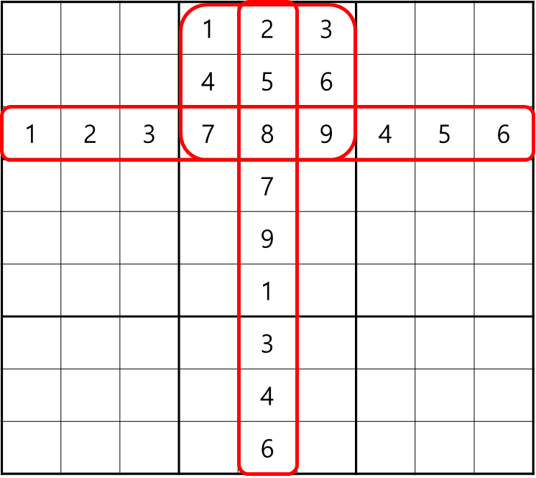
Sudoku Constraints
Each cell has 3 peers.
Only one number 1~9 can exist in each red box.
8

Slide 5
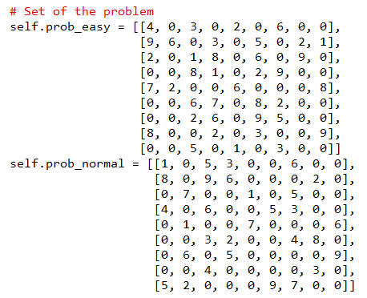
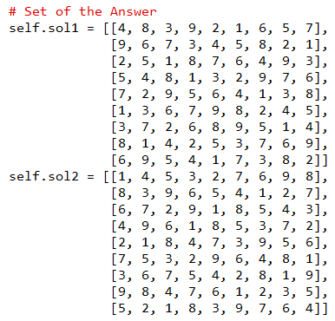
Problem Set Code
Empty!!

Slide 6
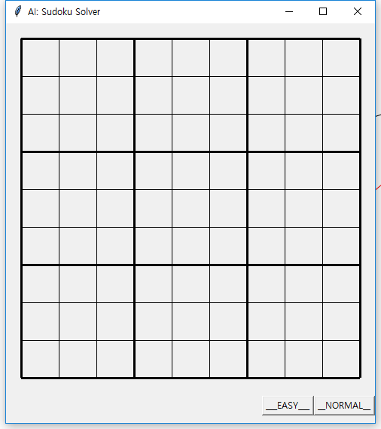
Problem Selection
1
Question: Black
2
Answer: Red

Slide 7
Need to Do
In “SudokuSolver” class, you need to complete “solver” function.
You can add any extra functions or classes, but always need to start from “solver” function.
In your search algorithm, you need to call display(i, j, k) function to display your searching process.
If you pass k=“”, the cell will be cleared.

Slide 8
Sudoku
(1,1) | (1,2) | (1,3) | (1,4) | (1,5) | (1,6) | (1,7) | (1,8) | (1,9)
(2,1) | (2,2) | … | … | … | … | … | … | (2,9)
(3,1) |  |  |  | … |  |  |  | …
(4,1) |  |  |  | … |  |  |  | …
(5,1) |  |  |  | … |  |  |  | …
(6,1) |  |  |  | … |  |  |  | …
(7,1) |  |  |  | … |  |  |  | …
(8,1) |  |  |  | … |  |  |  | …
(9,1) |  |  |  | … |  |  |  | (9,9)

Slide 9
Display(i, j, k) Example
1 | 5 | 6 | 9 | 8 | 7 | 2 | 3 | 4
8 | 7 | 2 | 3 | 5 | 4 | 6 | 9 | 1
4 | 9 | 3 | 6 | 1 | 2 | 5 | 8 | 7
9 | 6
3
display(4,3,1)
display(4,4,2)
display(4,5,3)
1
2
3
4
display(4,6,4)

Slide 10
Display(i, j, k) Example
1 | 5 | 6 | 9 | 8 | 7 | 2 | 3 | 4
8 | 7 | 2 | 3 | 5 | 4 | 6 | 9 | 1
4 | 9 | 3 | 6 | 1 | 2 | 5 | 8 | 7
9 | 6
3
display(4,3,1)
display(4,4,2)
display(4,5,3)
1
2
3
4
display(4,6,4)
display(4,6,””)

Slide 11
Display(i, j, k) Example
1 | 5 | 6 | 9 | 8 | 7 | 2 | 3 | 4
8 | 7 | 2 | 3 | 5 | 4 | 6 | 9 | 1
4 | 9 | 3 | 6 | 1 | 2 | 5 | 8 | 7
9 | 6
3
display(4,3,1)
display(4,4,2)
display(4,5,3)
1
2
3
display(4,6,4)
display(4,6,””)
display(4,5,””)

Slide 12
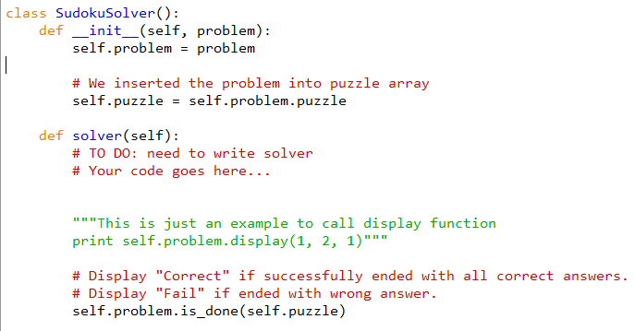
Solver Function

Slide 13
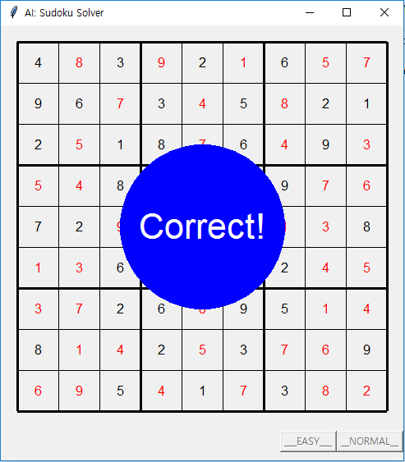
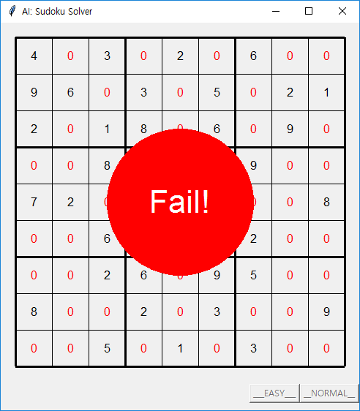
Result

Slide 14
DEMO !!!

